Slide 1
LLMs FOR SCENARIO GENERATION
Pang Kai Lin
Notes:
Note down specs needed to run the model.

Slide 2
TABLE OF CONTENTS
01
02
03
Workflow Change
Image Generation Model
Edited Final Prompt

Slide 3
01
WORKFLOW CHANGE

Slide 4


WORKFLOW
Production Workflow
This was what we discussed the previous meeting on how the trained LLMs will be used in production.
LLM 1
Flight Lead, Instructor
LLM 2
Mission Background
Flight brief, learning outcomes + generated mission background
Image Generation
Model
Pictorial Map
Output Scenario for AMT:
1000H: BLUELAND’s radar system detects REDLAND crossing warning line
1001H: BLUELAND sends 2 F-15 and 1 F-16 fighter jet southwest to REDLAND….

Slide 5
WORKFLOW
Generate map with the disposition of the target, threats blue/red boundaries etc
Development Workflow
This was what we discussed the previous meeting on the development workflow. However, due to the dataset constraints, I am proposing to omit LLM T. Instead of having an LLM generate the flight brief and learning outcomes based on the mission background, I intend to use a fixed flight brief, learning outcome and mission background.
LLM 1
Generate flight brief and learning outcomes and feed into LLM2 combined with mission background earlier
LLM T
LLM 2
Generate mission background consisting target and REDLAND information
Propose to Omit
Image Generation
Model
Output Scenario for AMT:
1000H: BLUELAND’s radar system detects REDLAND crossing warning line
1001H: BLUELAND sends 2 F-15 and 1 F-16 fighter jet southwest to REDLAND….

Slide 6


WORKFLOW
Generate map with the disposition of the target, threats blue/red boundaries etc
Proposed Training Workflow
Fixed prompts help reduce dataset variability and verify effect of training since I don’t have a large dataset for training. This will just be a proof of concept that training the model helps to refine the response if we have a sufficiently large dataset. Therefore, I need your help in crafting the fixed flight brief, learning outcome and mission background for LLM 2.
03
Fixed Prompt with required mission details and structure
Fixed flight brief, learning outcome and mission background
Fixed set of mission background(s)
LLM 1
Image Generation Model
LLM 2
Generate mission background consisting target and REDLAND information
Generate output scenario for AMT

Slide 7
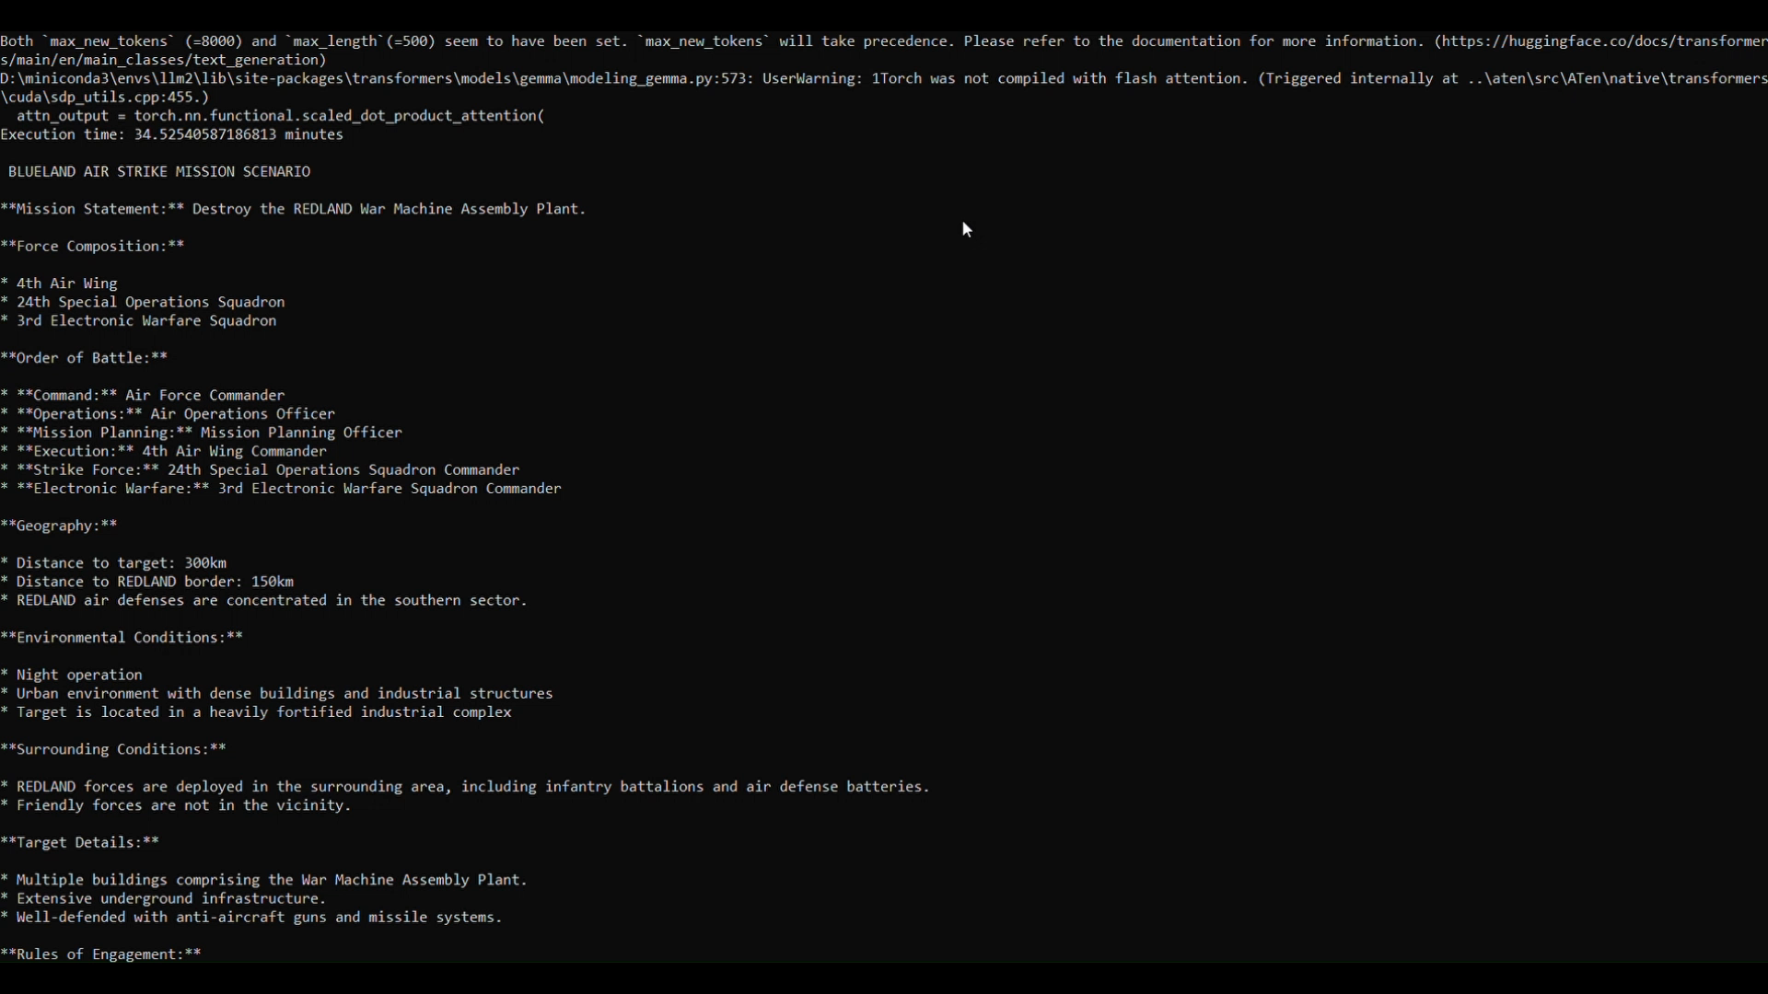
WORKFLOW
Sample Production Workflow (NOT FINAL)

Slide 8
02
IMAGE GENERATION MODEL

Slide 9
PROMPT FOR IMAGE GENERATION
Mission Statement: Conduct an air strike to destroy REDLAND's strategic petroleum reserve located at Grid Reference 45.6789° N, 23.4567° E.
Force Composition:
REDLAND's Air Defense Brigade:
2 x SAM Battalions, each with 8 launchers, located 10 km north and 15 km east of the target
1 x Fighter Squadron, with 12 aircraft, based at Airbase Delta (20 km west of the target)
1 x Radar Station, located 5 km south of the target
REDLAND's Ground Forces:
1 x Mechanized Infantry Battalion, with 15 tanks and 20 infantry fighting vehicles, located 12 km southeast of the target
Geography:
Distance to target: 140 km from BLUELAND's border
Distance to REDLAND threats:
SAM Battalions: 10 km north and 15 km east of the target
Airbase Delta: 20 km west of the target
Radar Station: 5 km south of the target
Mechanized Infantry Battalion: 12 km southeast of the target
Environmental conditions:
Nighttime mission, with scattered clouds and visibility of 5 km
Target located in a rural area, with surrounding hills and forests

Slide 10
PROMPT FOR IMAGE GENERATION
Surrounding Conditions:
REDLAND's Air Force is on high alert, with increased air patrols in the area
REDLAND's ground forces are conducting exercises 30 km north of the target, but are not expected to interfere with the air strike mission
BLUELAND's intelligence suggests that REDLAND has recently reinforced its air defenses in the area, but the extent of the reinforcements is unknown
Target(s) Details:
Primary target: REDLAND's strategic petroleum reserve, a large complex of storage tanks and pumping stations
Number of targets: 1
Target size: 1.5 km x 2 km
Target defenses: Unknown, but expected to include AAA guns and SAM systems
Rules of Engagement:
REDLAND's air defense units will engage any BLUELAND aircraft that enter their airspace
REDLAND's fighter aircraft will scramble to intercept BLUELAND aircraft within 10 minutes of detection
REDLAND's ground forces will respond to any BLUELAND aircraft that penetrate within 5 km of their positions
REDLAND's radar station will provide early warning and tracking data to REDLAND's air defense units
Given the mission background above, generate a map with the disposition of the target(s), REDLAND forces, BLUELAND and REDLAND boundaries, and any other additional positional information. Other information like the REDLAND forces’ capabilities and ammunition should be included in a table for easy reference.

Slide 11
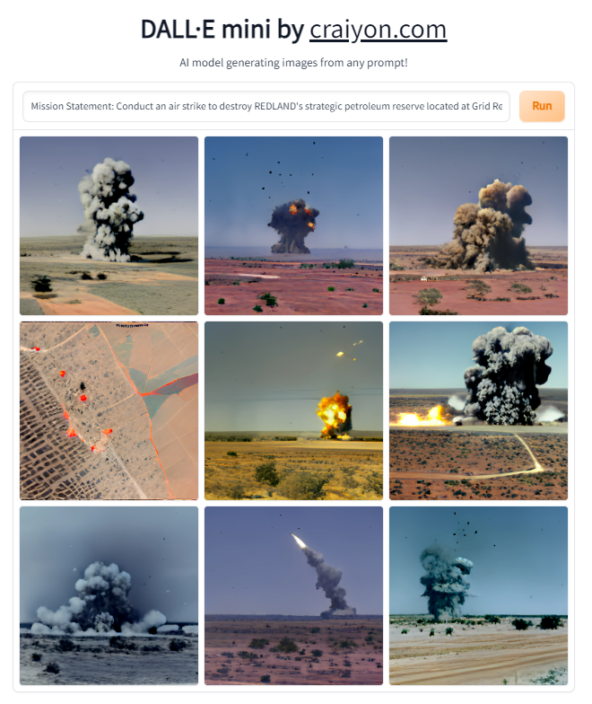
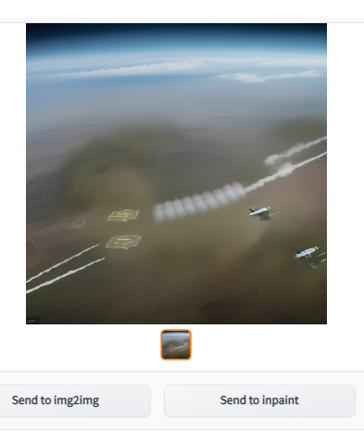
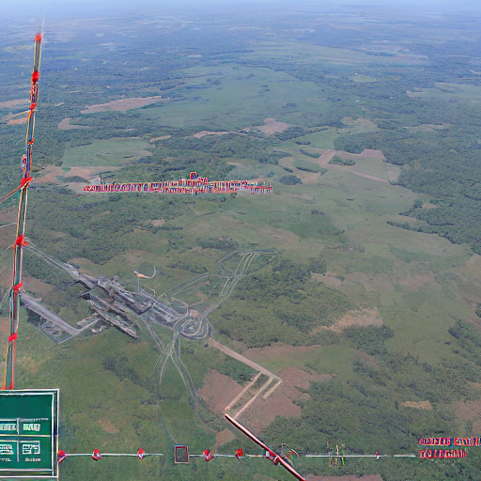
IMAGE GENERATION MODEL
DALL-E mini
Stable-Diffusion-Protogen-x3.4
CompVis/stable-diffusion-v1-4

Slide 12
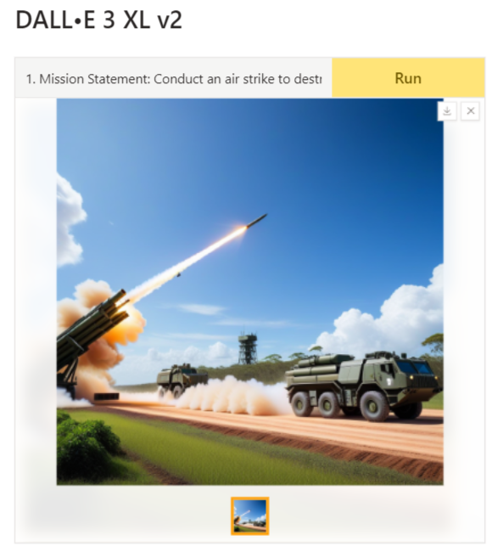
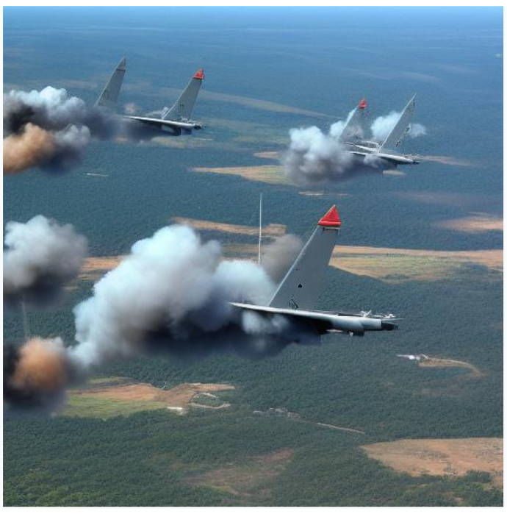
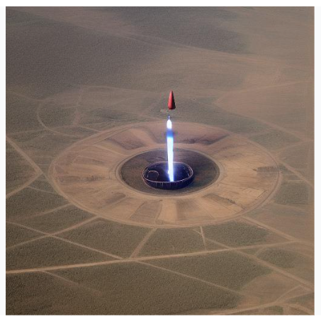
IMAGE GENERATION MODEL
DALL-E 3 XL v2
runwayml/stable-diffusion-v1-5
Kvikontent/midjourney-v6

Slide 13
OTHER POSSIBLE SOLUTIONS
Instead of creating a new map from scratch, use real-world coordinates and plot the map on a real-life map
Using the mission background, use a script to extract key parameters like target distance, BLUELAND REDLAND borders, etc, then input these key parameters into a map plotting software (eg: https://mgrs-mapper.com/) to generate the map.
Prompt engineering
I will be keeping this model in view and will work on the two LLMs first.

Slide 14
03
Prompt Engineering

Slide 15
REFINED PROMPT
Based on your most recent inputs, I have also refined the prompt for LLM 1. The changes are underlined in the next slide.
I am currently working on training the reward model for LLM 1 and LLM 1 itself and will keep you updated on the results! ☺

Slide 16
REFINED PROMPT
BLUELAND is a make-believe country. REDLAND is another make-believe country, an enemy of BLUELAND.
Write me a training scenario for an air strike mission by BLUELAND to destroy a specified target. This scenario will be given to BLUELAND, who will devise a strategy to execute the plan. The scenario should be non-descriptive, concise and factual. The information should be sufficient to help BLUELAND to decide their loadout and strategy. The scenario should include the following information about the target and REDLAND:
Commander’s Intent: Captures the broad mission objectives (eg: 100% TOT, 50% BLUELAND losses, 100% REDLAND destruction, destroy bunkers, etc)
Force Composition: REDLAND’s units and objects participating in the scenario, Order of Battle, i.e the identification, strength, command structure, disposition for the personnel, units, equipment of any military force, command & control hierarchies, communication networks and communication channels. This should be specific, i.e exact model of aircraft or missiles (eg: F-15 fighter jets, SA-7 surface-to-air missile launchers, ZSU-23-4 Shilka self-propelled anti-aircraft gun systems, etc).
Geography: Distance to target and distance to REDLAND threats in nautical miles (nm). Specification of environmental conditions which are of interest (eg: day/night/dawn, buildings, vegetation, ditches in surroundings, etc)
Surrounding Conditions: Overview of all scenario-related information of interest, i.e surrounding military situation, REDLAND readiness state, etc.
Target(s) Details: Any relevant information about target(s), i.e type and number of targets.
Rules of Engagement: Directives that outline when and how BLUELAND can engage hostile forces.

Slide 17
THANKS!

